Slide 1
literature
Anton Pavlovich Chekhov

Slide 2
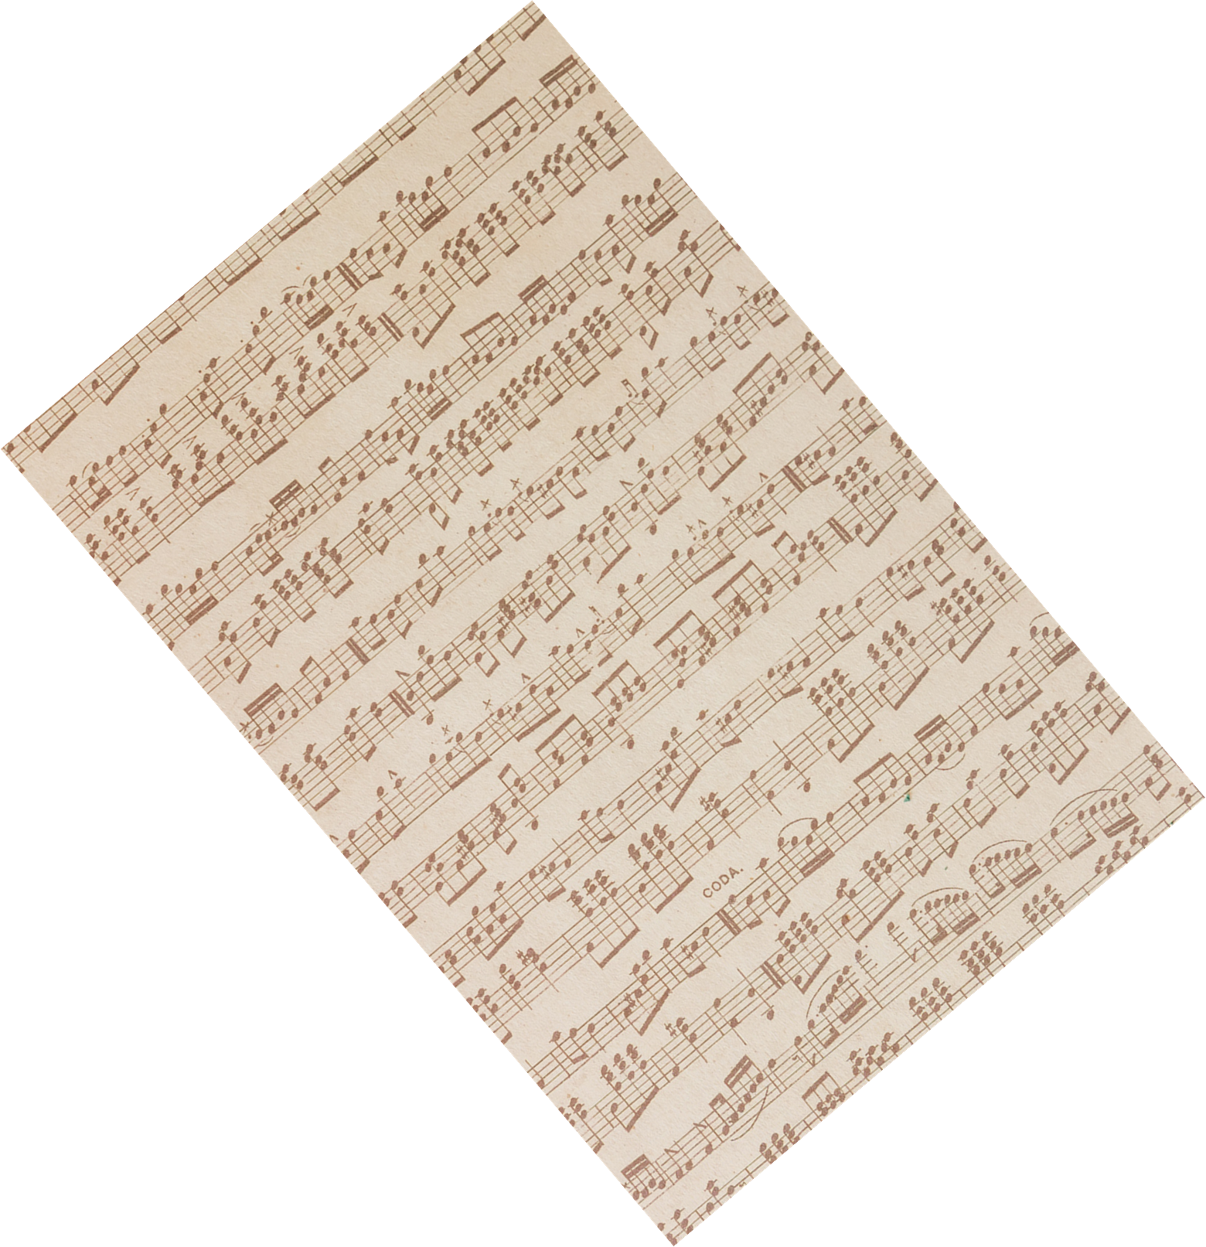
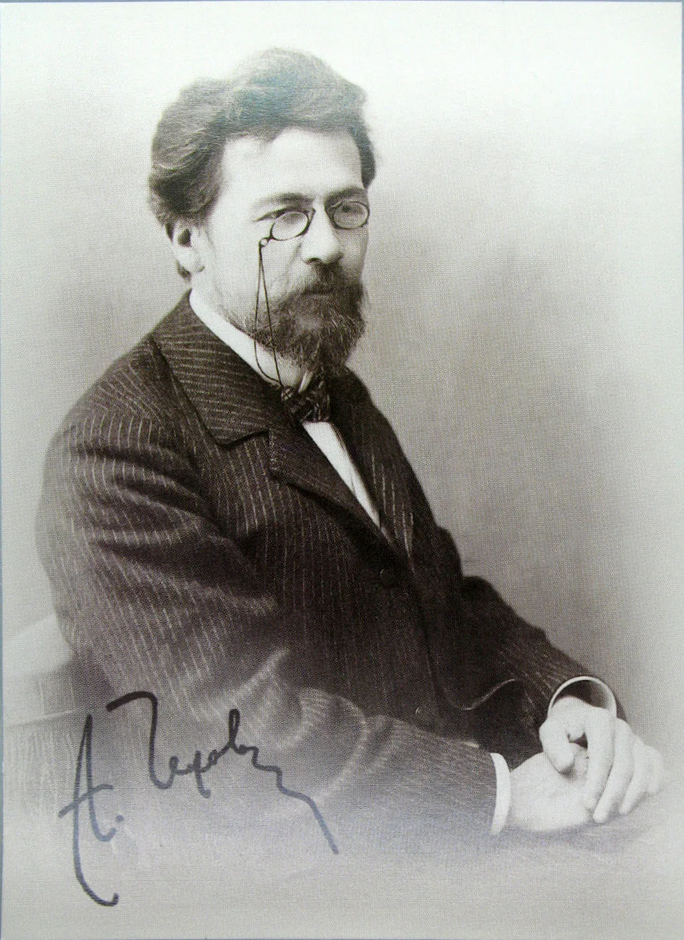
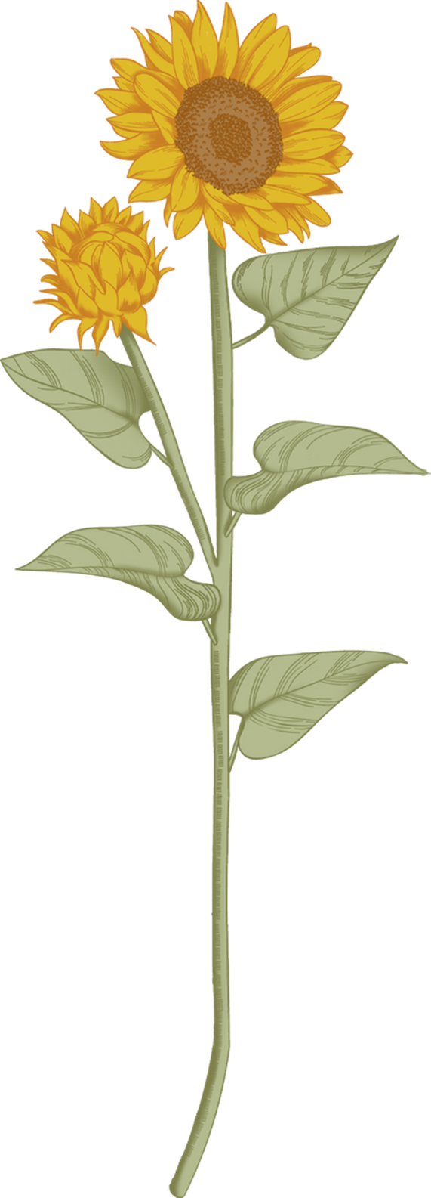
Anton Pavlovich Chekhov
was born in Taganrog, Russia. When he was 19 years old, he entered a medical school in Moscow and later became a doctor. He began publishing his stories while working as a doctor to help his family. By 1886, she had become known as an author of plays and short stories. Among his works are the play "The Seagull" (1896) and the famous short story "The Steppe" (1888).

Slide 3
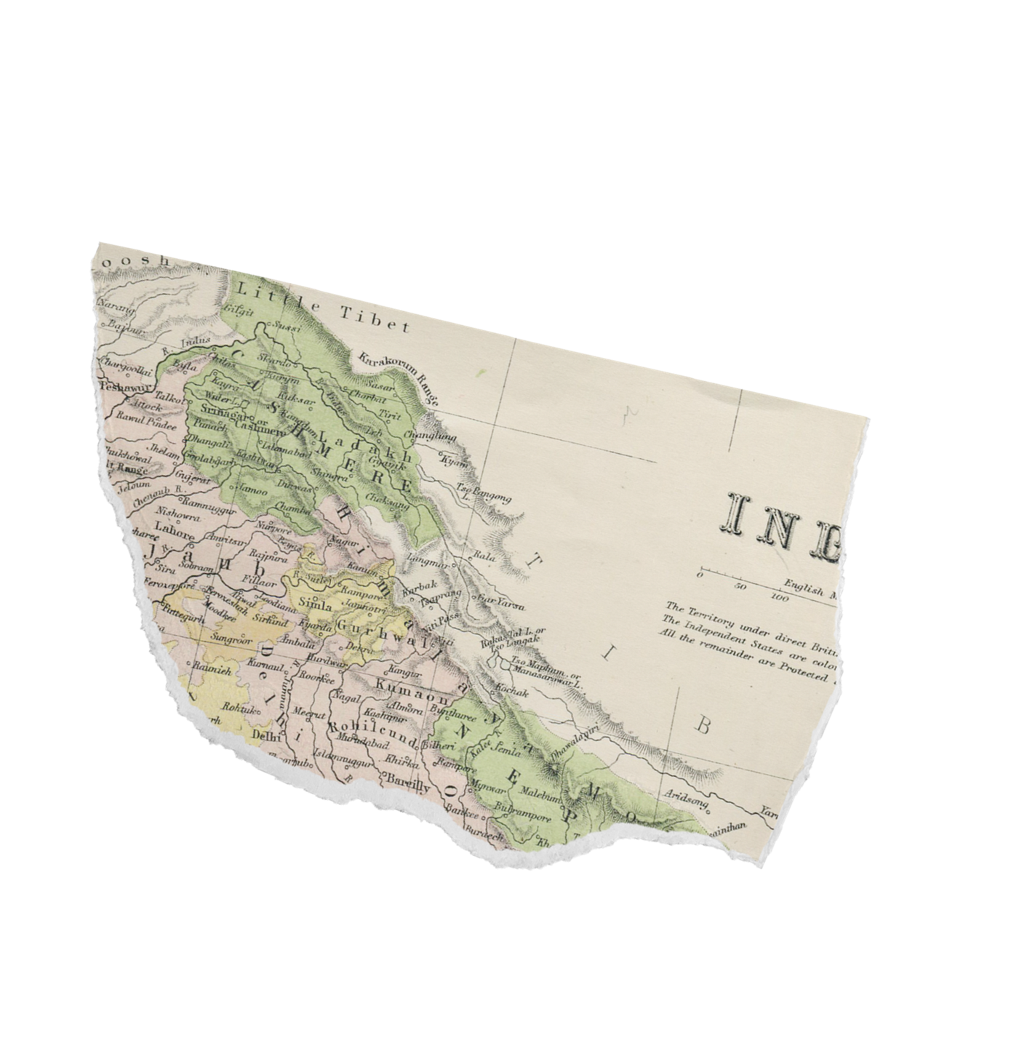
Popular works
«Cherry Orchard»
«Ward № 6»
«Lady with a dog»
«The man in the Case»
The play was the last in his work. Written in 1903, it was staged on the stage of his beloved Moscow Art Theater in 1904 and became the result of reflections on the fate of Russia..
The story was written and published in 1892 in the literary magazine "Russian Thought". This is one of the best works of the writer, in which he fully revealed the themes of loneliness, hypocrisy and vulgarity of life in the musty Russian outback.
Chekhov wrote the story in 1898. The work may have been based on events from the writer's life – acquaintance with his future wife O.L. Knipper, a trip to Yalta.
The story was written in 1898. The work is the first story of the "Little Trilogy" – a cycle that also includes the stories "Gooseberry" and "About Love"

Slide 4
Working with the textbook
Match the highlighted words in the text with their meanings below:
Rather fat
deeply
Set up, organized
pushed quickly and carelessly
Hard
awakened
left alone for a long time

Slide 5
The answers
abandoned - left alone for a long time (отказались - оставили в покое в течение длительного времени)
fixed up - set up, organised (устроенный - установленный, организованный)
sound - deeply (asleep (звучит - глубоко (спит)
shoved - pushed quickly and carelessly (сунул - толкнул быстро и небрежно)
stout - rather fat (полный - довольно толстый)
aroused - awakened (вызвали - проснулся)
difficult - hard (сложный - трудный)

Slide 6
Take a look at the list of emotions and feelings below.
Decide who felt them (Sasha or Olenka). Justify.
Sympathy | Irritation
Affection | annoyance
Embarrassment | happiness/joy
Sorrow | responsibility
Dedication | peacefulness

Slide 7
What is the role of books in our lives?
think about it and answer the question.

Slide 8
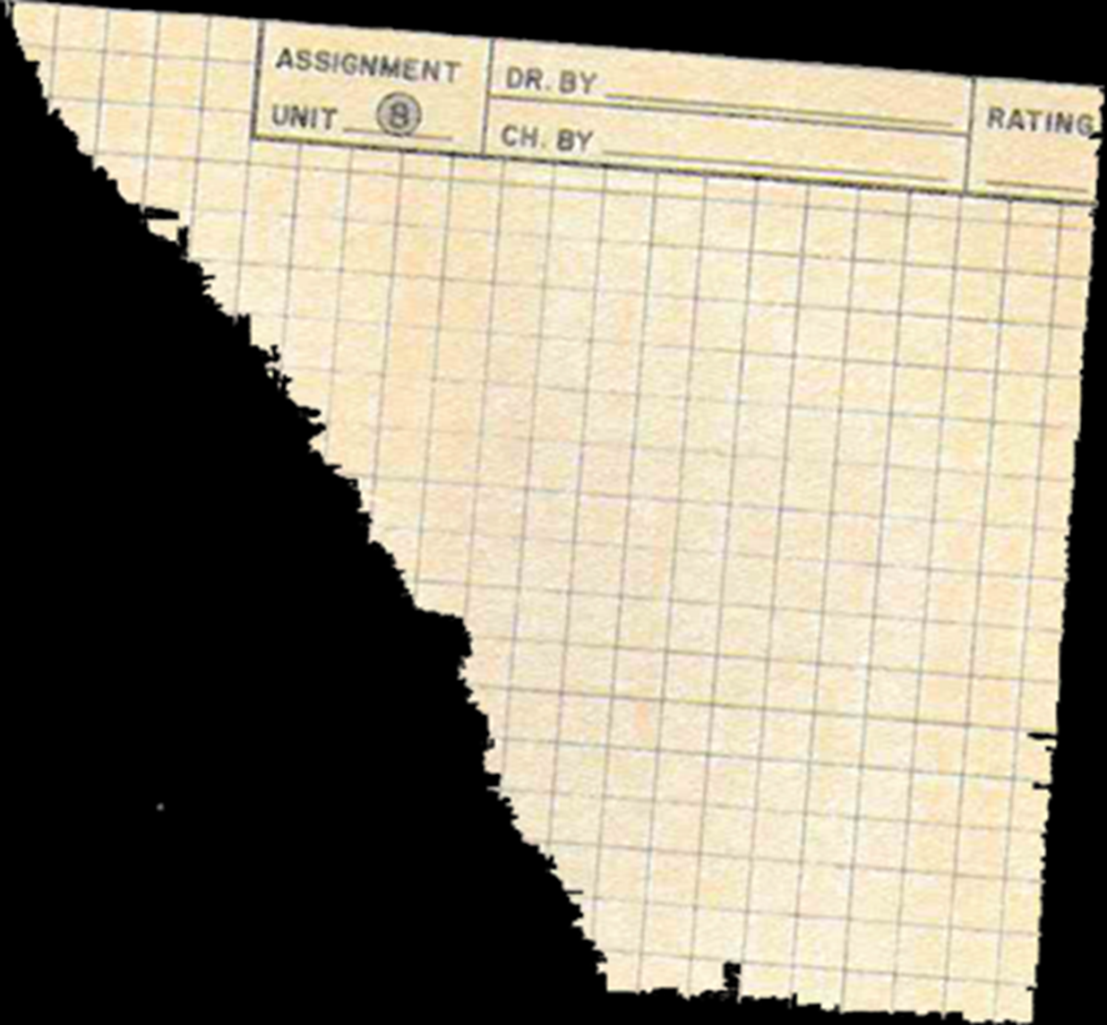
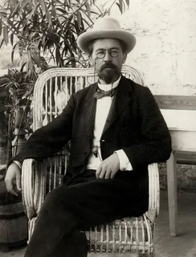
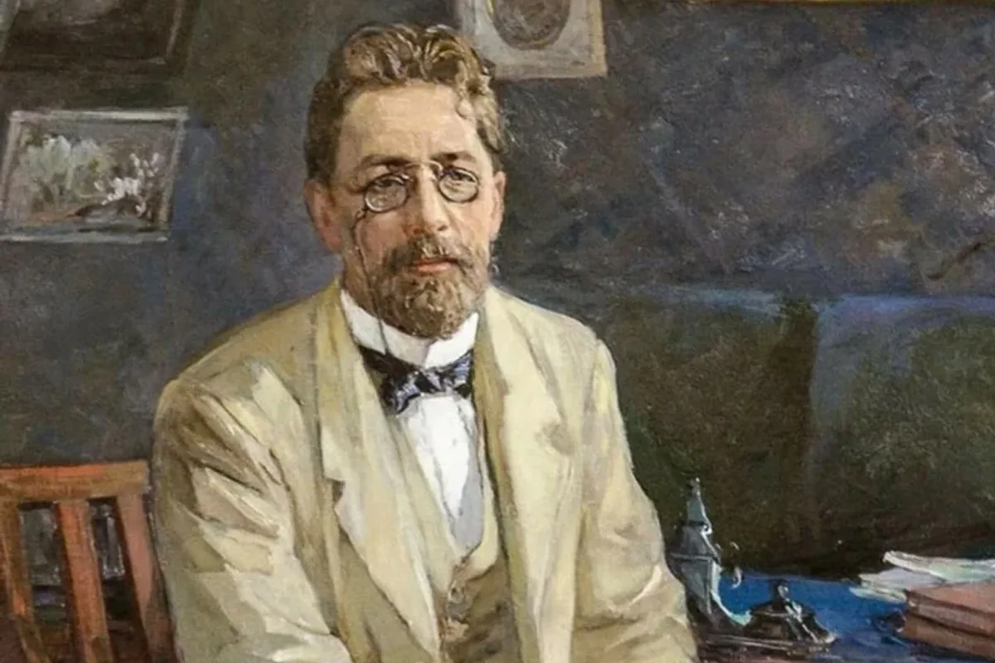
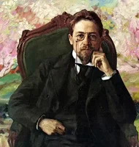
You do well if you read books
@Anton Pavlovich Chekhov

